Slide 1
Iphone Prototype
Group-D
Project: Charity Hub

Slide 2
How to Interact with Smartphone Prototype
Prototype -> Prototype Settings -> Click dropdown and Select any phone( works best on iPhone 16 Pro Max) -> Press Triangle “present” button.
In presentation mode: Go to “Flows” -> Select “Iphone Flow”.
And you’re set!

Slide 3



Home Page

Slide 4
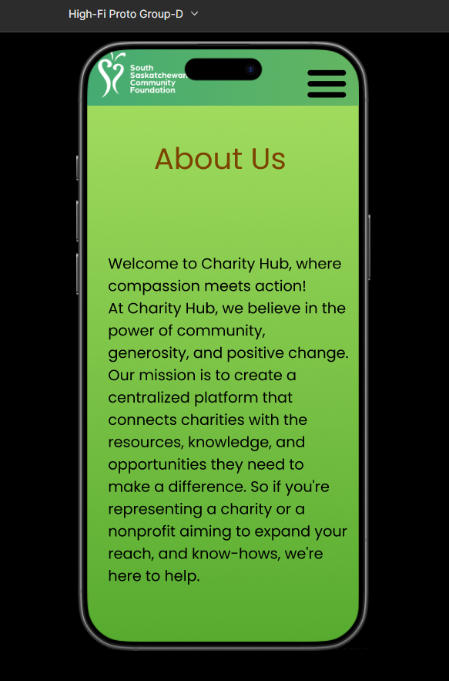
About Us Page

Slide 5
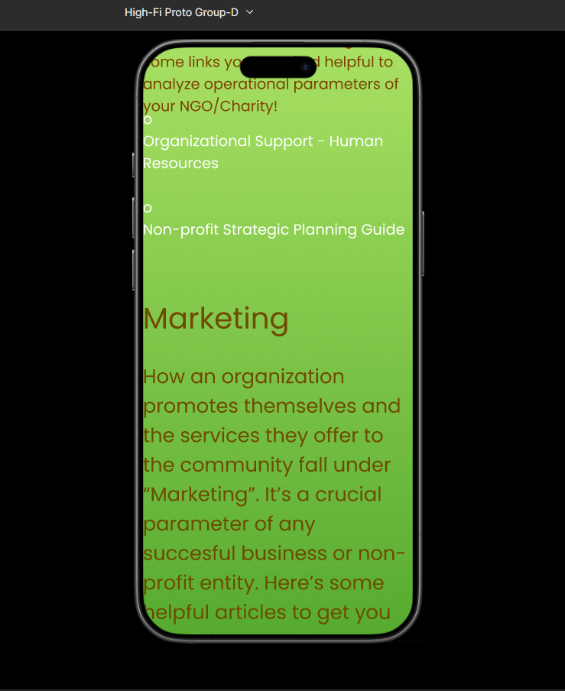
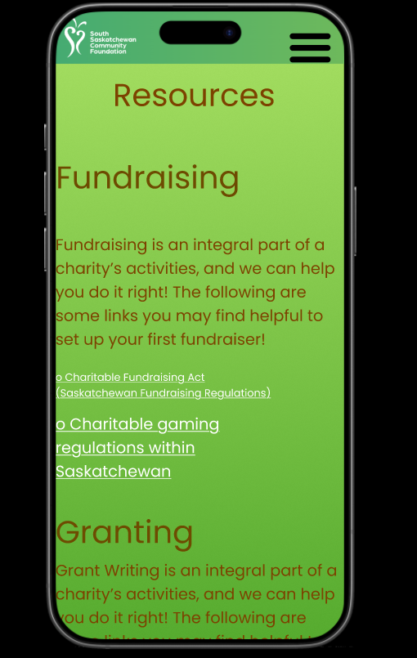
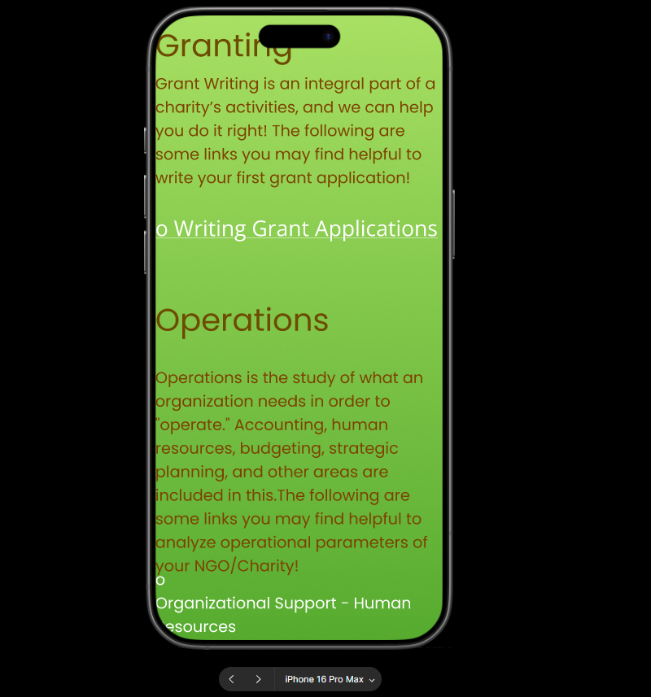
Resources Page

Slide 6
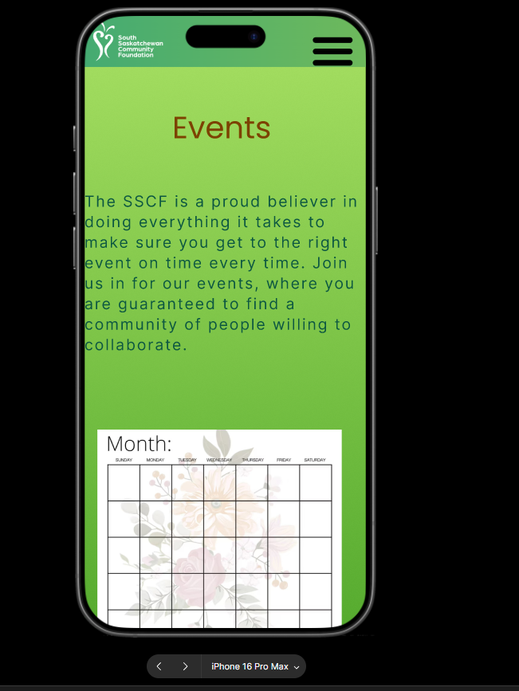
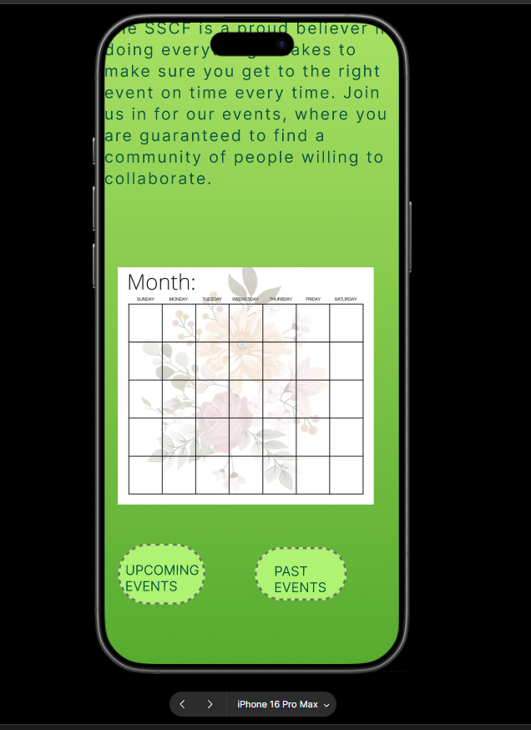
Events Page

